Slide 1
You Matter too!
Self-Care for Parents
By: Jessica Gonzalez, LMSW

Slide 4
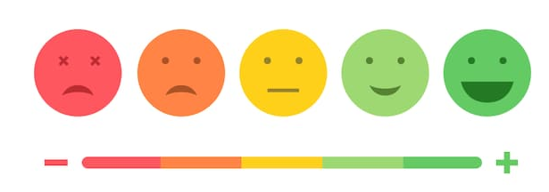

Slide 5
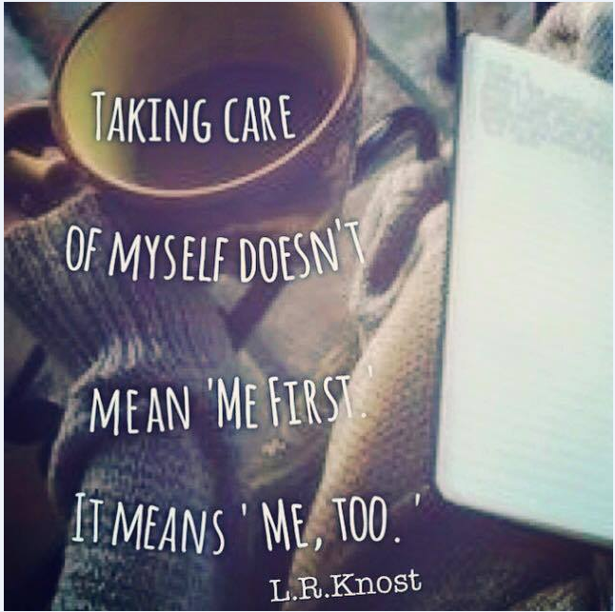
You have the greatest impact and are the most effective, when you take care of yourself.

Slide 6
Reasons why we don’t take care of ourselves
We are use to giving and feel uncomfortable receiving help
We feel guilty when we take care of ourselves
We don’t know enough about the benefits and impact of self-care
We don’t know how. How do we start eating better? What exactly do we do?
We don’t really think we need to take care of ourselves. We get by on “minimal”.
We don’t feel we deserve to take care of ourselves. Our value is tied to our output and that if we don’t work hard, people won’t respect us, like us, love us or want us.

Slide 7
Self-sacrificing vs Healthy Boundaries
I do so much and it goes unnoticed!
No one appreciates how hard I work!
I am the first one up and the last one to bed every day!
I don’t even have time to do anything for myself because I’m too busy giving to others.
I can’t say no or take the day off, my house will fall apart without me!

Slide 8
Parents are human too!
Stresses of life
Home, relationships, work, basic needs, mental health, physical health, responsibilities
Learning how to parent uniquely for each stage and each child
Have dreams, hopes and goals as an individual
Perhaps caring for other family members

Slide 9
What happens to a PARENT when he/she neglects self care?
Increased stress on their mind and body
Physical effects
Weaker immune system
High blood pressure
Mental health impact
Depression
Anger
Strained relationships
Guilt

Slide 10
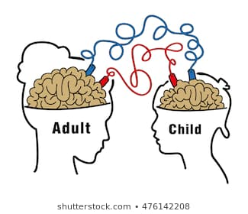
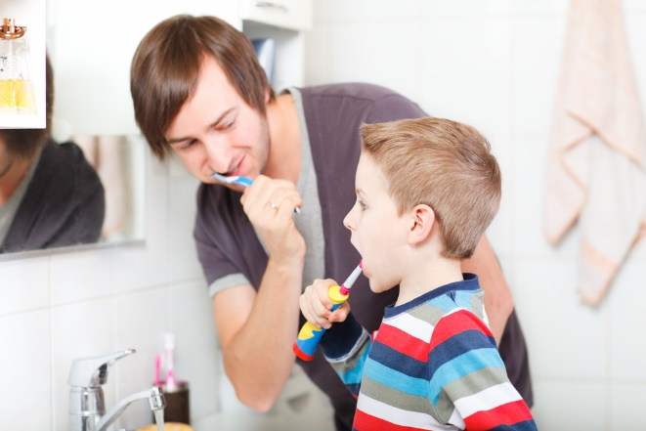
What happens to a CHILD when a parent neglects self care?
Send the message that our needs are not important
Diminish the importance of healthy habits
Model passive communication
Decrease their ability to listen to their own needs in all areas

Slide 11
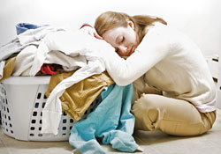
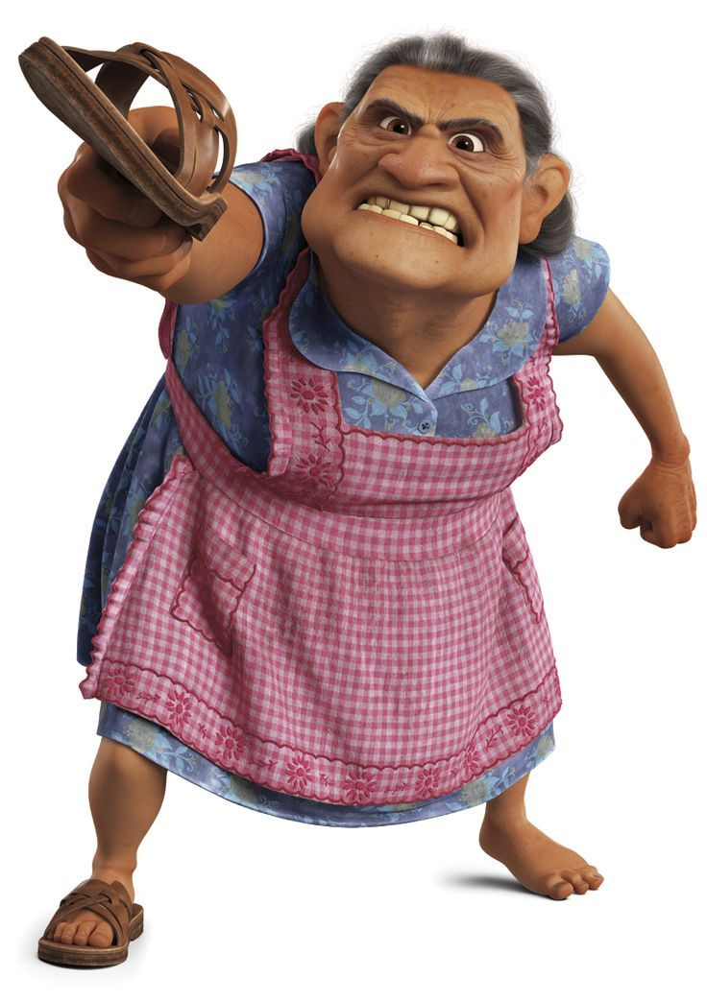
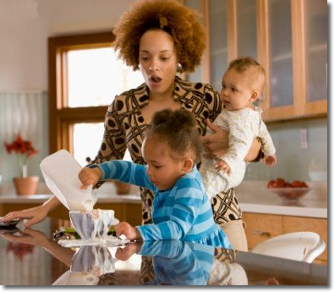
Not self-caring, makes parenting HARDER!

Slide 12
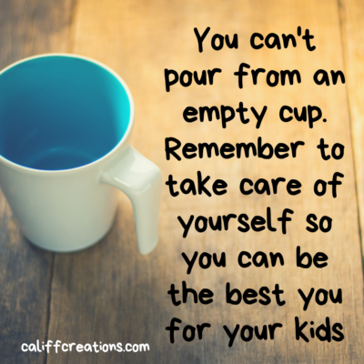

Slide 13
You have permission to set healthy boundaries & to self-care!
Learn how to say no and when to say yes
Identify what you are doing that is working & what brings you energy & joy
Build a healthy support system, e.g. toxic friendships
Ask for help and communicate your struggles to find solutions
Consider seeking out help to explore underlying emotions

Slide 14
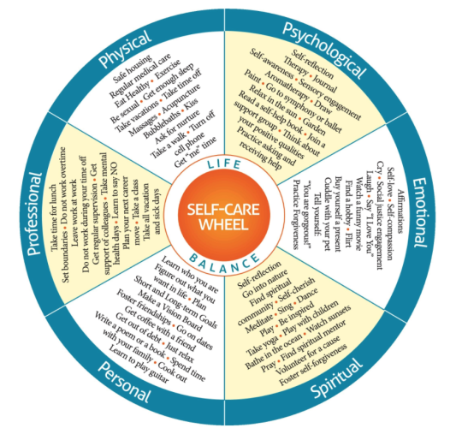

Slide 16
Using Positive Self-talk to Cultivate Resilience

Slide 17
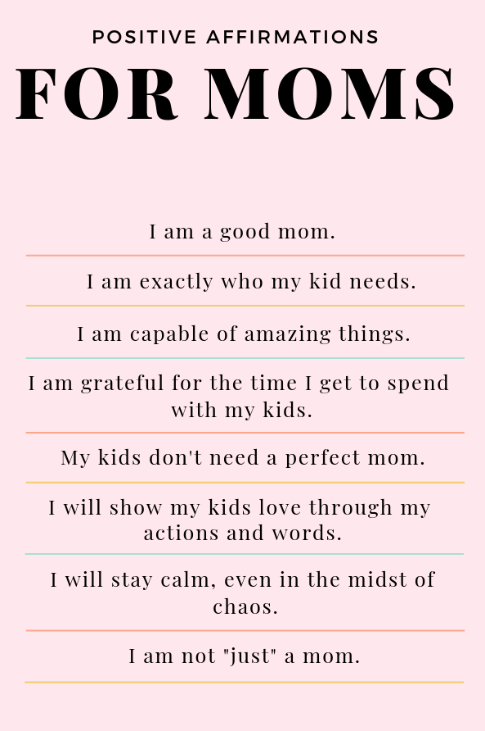

Slide 19
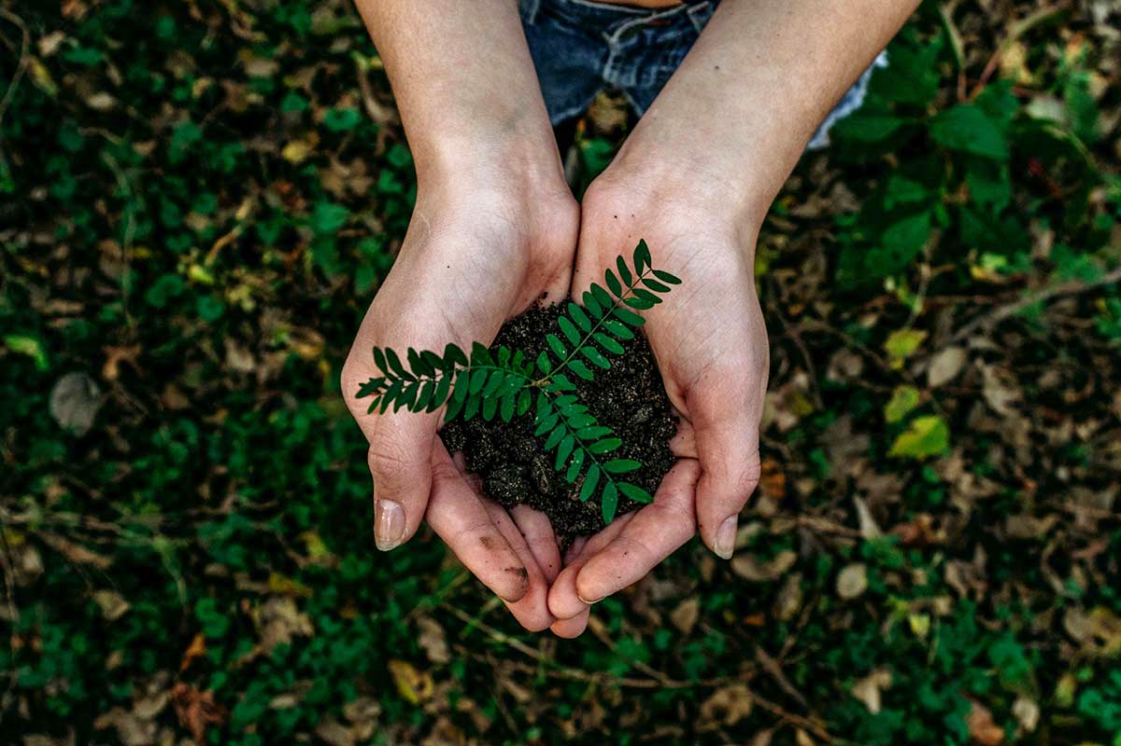

Slide 20
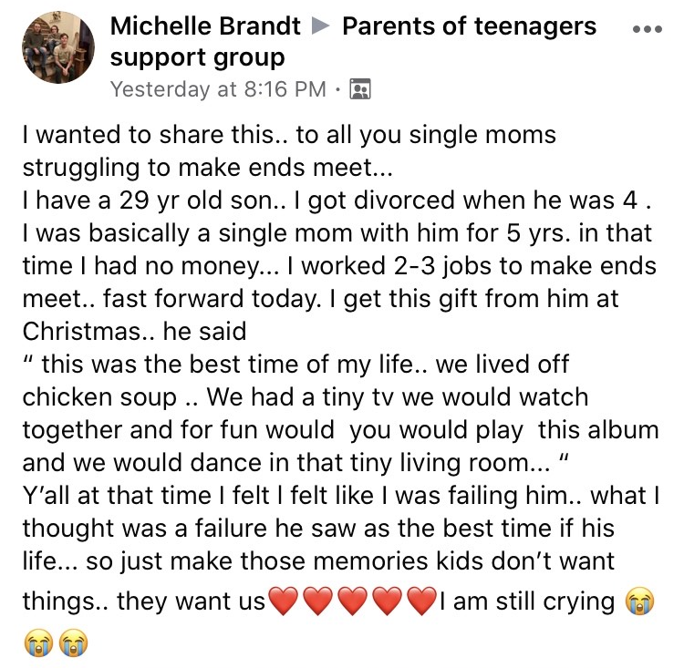
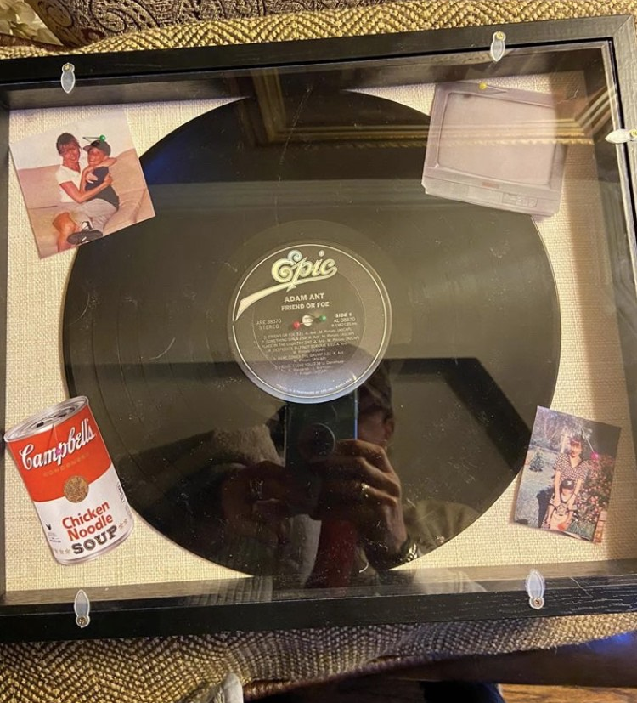

Slide 22
Parent Workshop #4
Special Education 101:
What Parents Need To Know About Learning Disabilities
Wednesday, January 29th
8:15 am

Slide 23
You Matter too!
Self-Care for Parents
By: Jessica Gonzalez, LMSW

